Slide 1

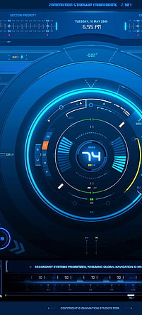
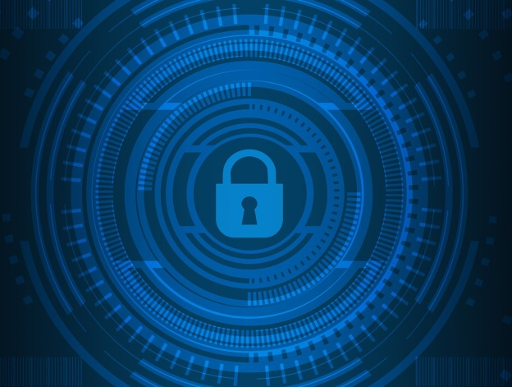
A CYBER INSURANCE SCHEME FOR WATER DISTRIBUTION SYSTEM
SOWMIYA.P (510219104003)
SWATHI.S (510219104004)
JAKULINRANI.K (510219104002)
SWETHA.K (510219104304)
GUIDE Mr.M.KARTHIKEYAN.,B.Tech.,.M.E.

Slide 2
AGENDA
ABSTRACT
EXISTING SYSTM
LITERATURE SURVEY
PROPOSED SYSTEM
ADVANTAGE
DISADVANTAGE
SYSTEM ARCHITECTURE
SYSTEM SPECIFICATION
ALGORITHM
MODULE DISCRIPTION
CONCULSION
SCREENSHOT

Slide 3
Abstract
The water distribution system supports our daily life and economic growth, the failure of which may lead to catastrophic results. Besides the uncertainty from the system component failures, cyber-attacks are vital to the secure system operation and have great impacts on the reliability of the water supply service.
Malicious attackers may intrude into the supervisory control and data acquisition system of pump stations in the water distribution networks and interrupt the water supply to the customers.
Cyber insurance is emerging as a promising financial tool in system risk management. In this paper, cyber insurance is proposed for the cyber risk management of the water distribution system.
A semi-Markov process (SMP) model is devised to model the cyber-attacks against pump stations in the water distribution system.

Slide 4
Existing System:
Some existing studies on cyber security characterization have mostly considered the cyber security from a qualitative perspective. So far, very few studies have considered the quantitative assessment of cyber security.
Therefore, it is of great importance to evaluate the impacts of the cyber-attacks on the water distribution network in a quantitative manner. From the systems analysis perspective, there are some similarities between the failures caused by accidental faults such as system components failures or human errors and the failures due to cyber-attacks.

Slide 5
A sequential Monte Carlo Simulation (MCS) based algorithm is developed to evaluate the system loss. Cyber insurance premiums for the water distribution networks are designed based on the actuarial principles and potential system losses.
Case studies are also performed on multiple representative water distribution networks, and the results demonstrate the validity of the proposed cyber insurance model.

Slide 6
LITERATURE SURVEY: A review of cybersecurity incidents in the water sector
This study presents a critical review of document on malicious cybersecurity incidents in the water sector to inform safeguarding efforts against cybersecurity threats.
Fifteen incidents were selected and analyzed through a search strategy that included a variety of public information sources ranging from federal investigation reports to scientific papers. For each individual incident, the situation, response, remediation, and lessons learned were compiled and described. The findings of this review indicate an increase in the frequency, diversity, and complexity of cyberthreats to the water sector.

Slide 7
Stealthy deception attacks on water SCADA systems
Ensuring security of systems based on supervisory control and data acquisition is a major challenge. The goal of this paper is to develop the model-based techniques capable of detecting integrity attacks on the sensors of a control system.
In this paper, the effect of integrity attacks on the control systems is analyzed and countermeasures capable of exposing such attacks are proposed. The main contributions of this paper, beyond the novelty of the problem formulation, lies in enumerating the conditions of the feasibility of the replay attack, and suggesting countermeasures that optimize the probability of detection by conceding control performance.

Slide 8
Proposed System:
A modified semi-Markov process (SMP) model incorporating a stochastic cyber risk correlation model is proposed to evaluate the potential cyber security threats against the system in the water distribution network.
Based on the proposed model, both the independent cyber risk within the individual water network and the correlated common cyber risks shared across different water networks can be considered and evaluated.
A Monte Carlo simulation (MCS) based quantitative risk assessment approach is developed to estimate the impact of malicious cyber-attacks on water distribution system reliability.

Slide 9
Advantage:
An integrated risk evaluation of the water system incorporating the impact of cyber-attacks is very meaningful in enabling more informed decision making.
One efficient way is to adopt the recently developed cyber insurance policies, which are the policies that provide coverage against the overall system losses from network related issues in cyber security.
Is to adopt the recently developed cyber insurance policies, which are the policies that provide coverage against the overall system losses from network related issues in cyber security

Slide 10
The authors of analyzed the risk management strategies of companies when the risks are interdependent. The study shows how the interdependence of cyber risks reflects on the incentives to invest in security technologies and to buy insurance coverage.

Slide 11
DISADVANTAGE:
Cyber-attacks can bring potential threats to the water systems. Some existing studies on cyber security characterization have mostly considered the cyber security from a qualitative perspective.
Abnormal operations of the physical components due to cyber-attacks may increase the stress of the system operator as well, so that human errors are more likely to happen in such cases
With the increasing risks of substantial economic losses due to cyber-attacks, additional tools to manage the cyber security risks are strongly urged.

Slide 12
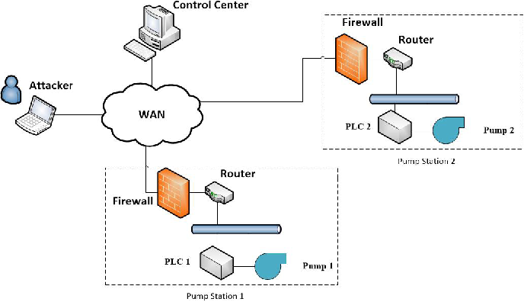
SYSTEM ARCHITECTURE

Slide 13
The water distribution network, which is used to control and monitor the distribution of the water. The control center and the geographically distributed pump stations are connected through a complex wide area network (WAN). The operators in the control center monitor the statuses of the field devices and send out operation commands.
Architecture in water distribution system focus the attacker successfully intrudes into the control network, various malicious actions can be possibly done, such as shutting down pumps, sending out false operation commands, and interrupting the information systems. All these malicious actions will possibly result in serious system failures.

Slide 14
SYSTEM SPECIFICATION:
Hardware Requirements:
System | : Pentium IV 2.4 GHz
Hard Disk | : 40 GB
Floppy Drive | : 1.44 MB
Monitor | : 15 VGA Colour
Mouse | : Logitech
RAM | : 256 MB

Slide 15
Software Requirements:
Operating system | : Windows 7
Front End | : JAVA or JSP
Database | : SQL SERVER 2008
Tools | : Eclipse IDE

Slide 16
Algorithm Used:
When the same operation software stack is installed on another distribution network, the software vulnerability is shared among them. These shared vulnerabilities can lead to correlated cyber risks of multiple water networks and result in greater loss.
What’s more, the information technology infrastructure of various water utilities is dominated by a few similar technologies that may also leave these utilities with the same potential vulnerabilities, which means although the water utilities are not physically connected to each other, they may share correlated common cyber risks.
This kind of cyber risk correlations across various water utilities cannot be modeled through the traditional algorithm of risk analysis. Consequently, a stochastic model is highly

Slide 17
Module Description:
1.Cyber security
Cyber insurance is a risk management technique via which network users’ risks can be transferred to an insurance company in return for the insurance premium. With the increasing cyber security risk of critical infrastructures, and in combination with the need for compliance with recently enforced corporate regulation, the demand for cyber insurance has significantly increased. While the critical infrastructures are becoming more and more dependent on their networked operation systems, more potential vulnerabilities are exposed to the cyber-attacks than before.

Slide 18
2.Cyber insurance
Cyber insurance is emerging as a promising financial tool in system risk management. In this paper, cyber insurance is proposed for the cyber risk management of the water distribution system. A semi-Markov process (SMP) model is devised to model the cyber-attacks against pump stations in the water distribution system. Both the impacts of the independent cyber risks in the individual distribution network and the correlated cyber risks shared across different water distribution networks are evaluated and modeled.

Slide 19
3.Water distribution system
Cyber-attacks and physical failures may happen simultaneously to trigger more significant impacts on the overall system. This kind of combinational failures could directly result in the interruption of water services.
Therefore, in this paper the impact due to cyber security threats against the water distribution system is considered in performing the reliability assessment. Failures in the cyber infrastructure (e.g., the wrong control signals or false system information) could mislead the system operator to make uninformed decisions which may result in system failures.

Slide 20
4.Reliability evaluation
Various probabilistic reliability evaluation algorithms have been developed and applied to critical infrastructures. When performing system-level reliability evaluation, a wide spectrum of factors may lead to a system failure.
The physical component failures could be triggered and consequently lead to an overall system failure. However, for modern critical infrastructures, more factors or uncertainties such as cyber-attacks should be taken into consideration when designing effective protection mechanisms to ensure reliable performance of the systems.

Slide 21
Conclusion
This paper proposes a modified semi-Markov process (SMP) incorporating a cyber-risk correlation model to evaluate the potential cyber security threats against the SCADA system in the water distribution network. By applying the proposed approach, both the independent cyber risks within one individual water network and the correlated cyber risks across different water utilities can be considered. A sequential Monte Carlo simulation-based algorithm is also developed to assess the overall system loss and the failure event duration considering two types of cyber-attack scenarios against the water distribution networks.

Slide 22
The total cyber-insurance premium can be estimated based on the designed actuarial principles. After that, the premium allocation for each individual water utility is further determined with regards to its individual risk level. The results of the case studies indicate that higher system reliability and more advanced self-protection mechanism can reduce the cyber-insurance premium of the water utilities with the proposed actuarial principles.

Slide 23
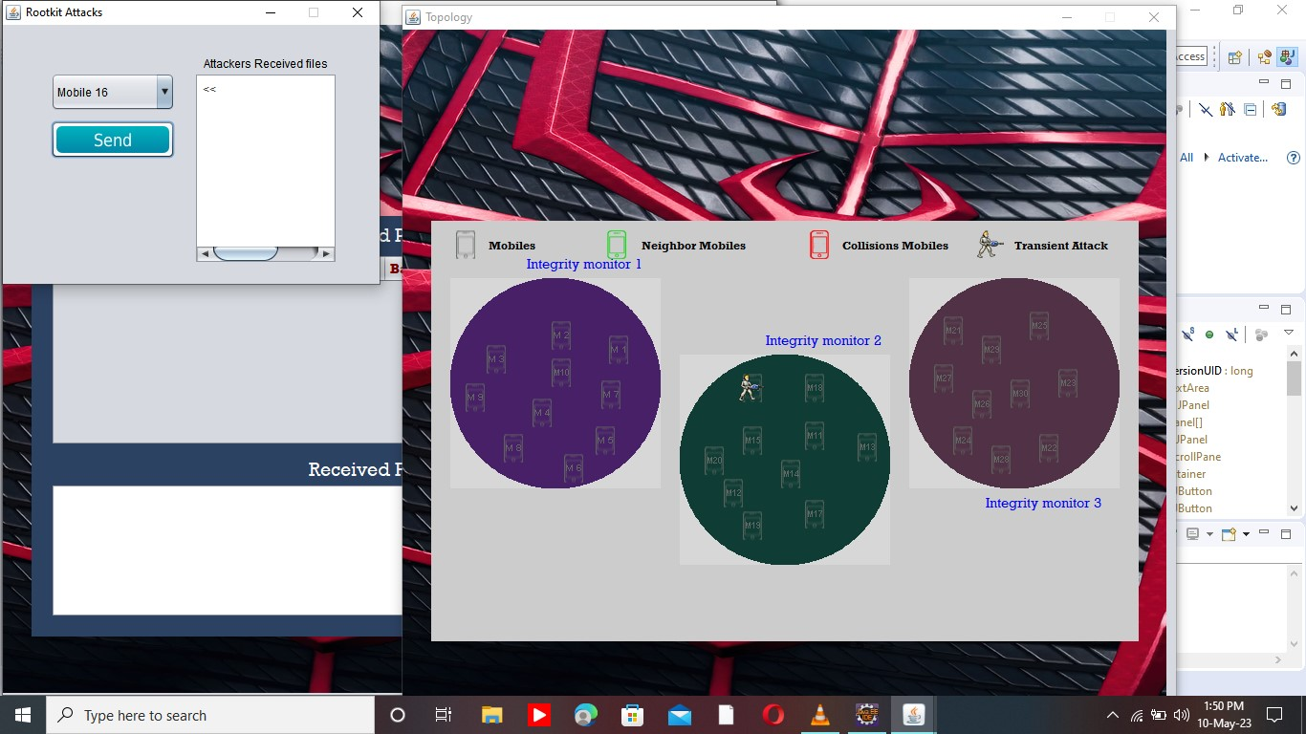
Screenshot:
Choosing the mobile 16 for attack

Slide 24
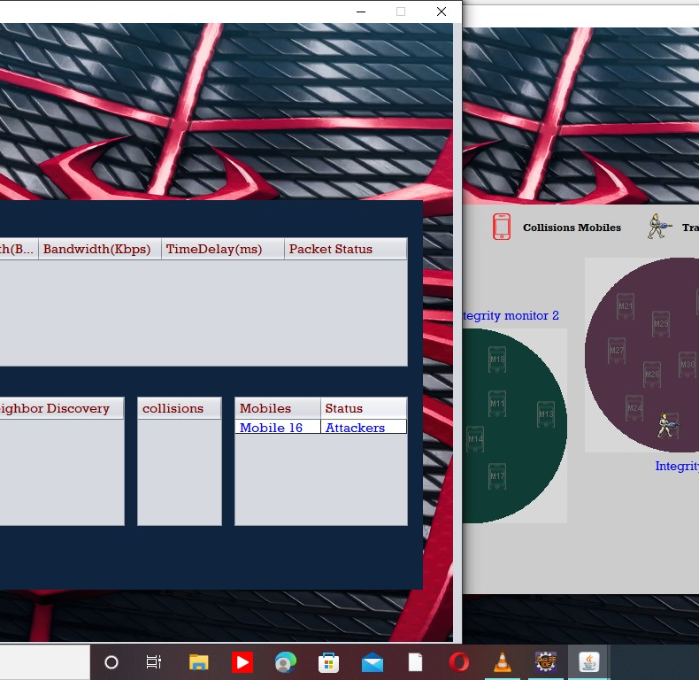
Mobile 16 attacks the system.

Slide 25
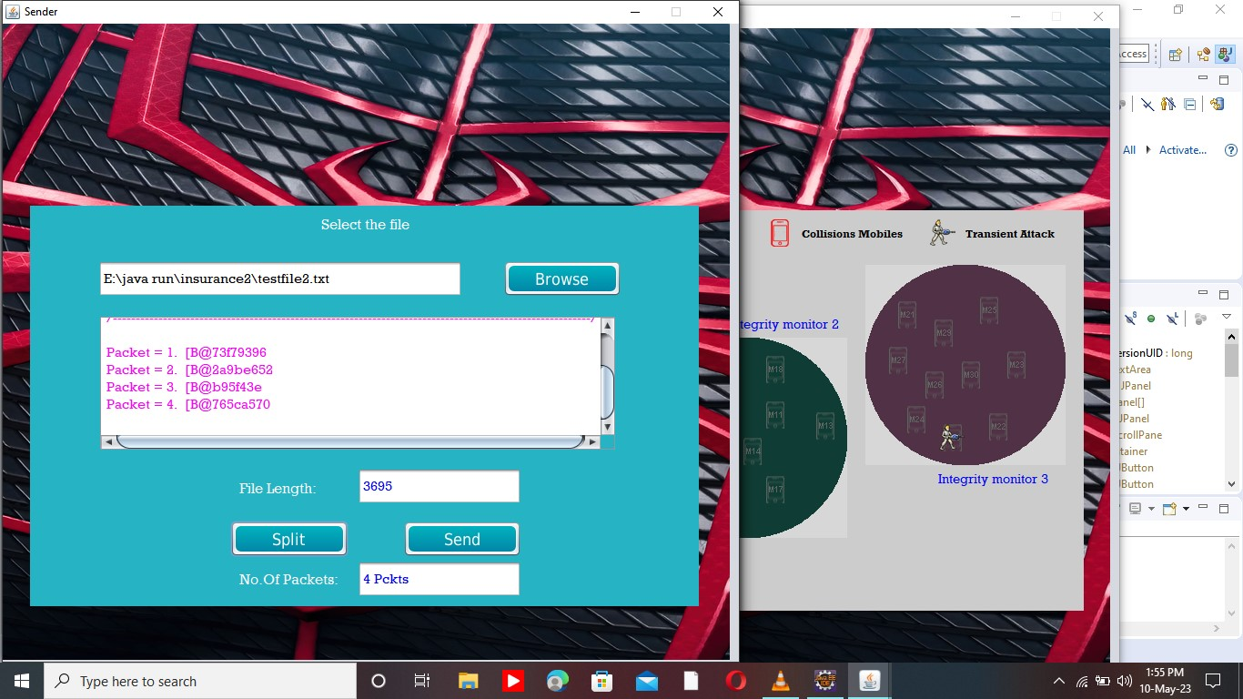
Sending malware file to the system.

Slide 26
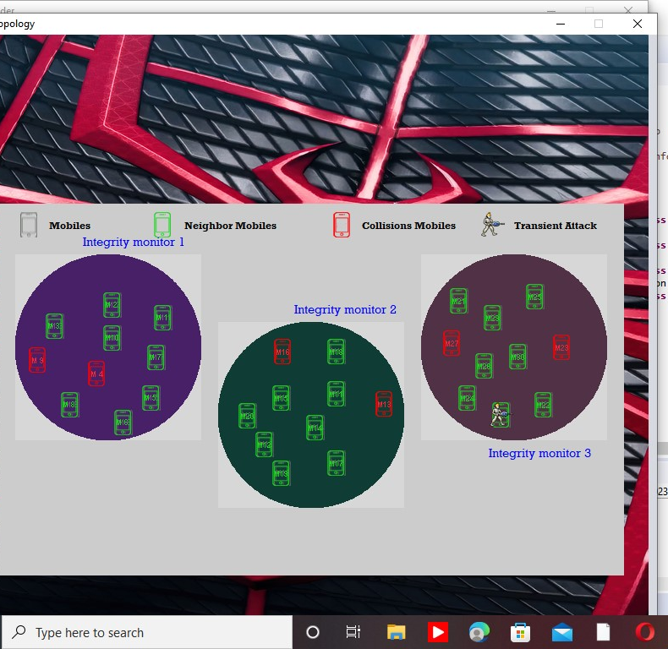
Attacked area turn from green to red.

Slide 27
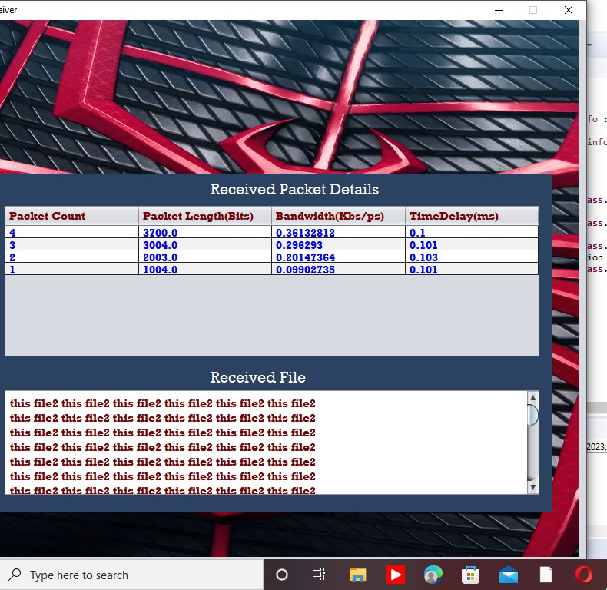
Finding the length and other deatil of packet recevied.

Slide 28

THANK YOU!

